Slide 1
Unfit Vehicle Detection
SAFER INDIA HACKATHON
TEAM NAME: CodeCult

Slide 2
SITUATION
Cause of concern:
Old vehicles constitute < 1 % of the total fleet - but contribute 15% of total vehicular pollution.
It is estimated that India will have over 2 crore unfit vehicles by 2025.
11 / 12 cities with the highest levels of particulate pollution are located in India.
There are just 75,000 traffic cops to manage 20 crore vehicles.

Slide 3
COMPLICATION
SOLUTION
Manual identification and persuasion of so many vehicles is an impractical task
Automating the entire process and reducing the amount of manual labour, cost and time consumed

Slide 4
PIPELINE
Cameras pick up Video Feed
OCR to extract Vehicle Number
Flag vehicle if Unfit
Traffic Cameras across the city capture video feed which is processed on a server.
OCR will recognize the text from the number plate and store it as text.
Vehicle will be flagged as unfit if its fitness expiry date has passed.
1
2
3
4
5
Plate Localization
Database Check
The deep learning algorithm designed using YOLO and OpenCV detects the number plate.
Vehicle details will be checked in the database.

Slide 5
TECHNOLOGY
Deep Learning -
YOLO - This is an extremely fast real-time object detection algorithm. We used this to detect and separate the number plate from the image/frame.
Tesseract - Tesseract is an optical character recognition engine for various operating systems. Once the YOLO algorithm detects the number plate, Tesseract will parse the vehicle number from it.
2. Image Processing -
OpenCV - We used OpenCV to remove any noise from the image and to grayscale the image of the number plate received, before sending it to Tesseract OCR to recognize the text on the number plate.

Slide 6
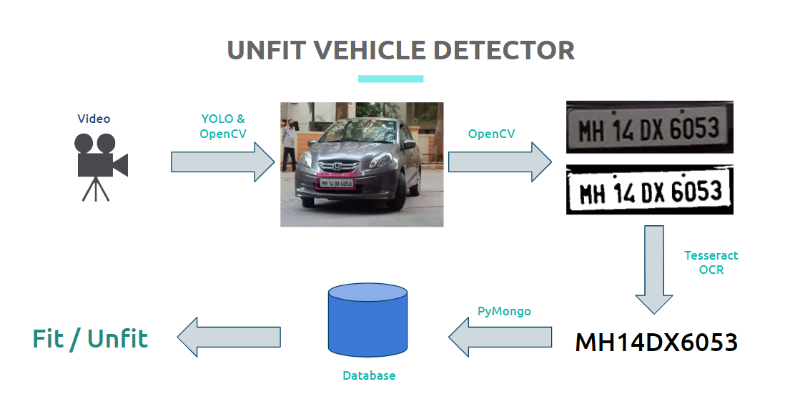
Flow
The process flow of our proposed solution.

Slide 7
ADDITIONAL PROBLEMS SOLVED
SECURITY
SPEEDING DETECTION
TRAFFIC MANAGEMENT
PUCC AND INSURANCE
HELMET DETECTION
CRIME DETECTION
Persons of interest/suspect can be tracked or triangulated
Avg speed of a vehicle between two points can be determined, sanctioning those who sped over the limit
Areas with constant congestion can be monitored and vehicles can be taxed
PUCC and insurance validity can be checked
This algorithm can be further trained to detect helmets or lack thereof
Vehicle theft can be automatically tracked when alerted.

Slide 8
Existing Systems
London congestion charge
A System that charges motorists entering a specific busy area between 7 a.m. and 6:00 p.m
Italy
Italy found a 22% drop in road accidents reducing mortality rate by 50%, and injury rate by 34%
Belgium
The city of Mechelen uses an ANPR system to scan all cars crossing the city limits. Cars listed on 'black lists' generate an alarm, so they can be intercepted by a patrol.
Australia
The system identifies unregistered and stolen vehicles as well as persons having an outstanding warrant

Slide 9




Thank you for this opportunity!
THE TEAM
SOHAM KULKARNI
KRISHIV DAKWALA
VISHWAJIT SHELKE
SOURAV KOTKAR

Slide 10
REFERENCES
https://www.udemy.com/course/training-yolo-v3-for-objects-detection-with-custom-data/
https://pjreddie.com/darknet/yolo/
https://docs.opencv.org/master/
https://github.com/RobertLucian/license-plate-dataset
https://www.kaggle.com/andrewmvd/car-plate-detection
https://timesofindia.indiatimes.com/india/just-72000-traffic-cops-to-manage-20-crore-vehicles/articleshow/71030303.cms#:~:text=NEW%20DELHI%3A%20The%20total%20strength,and%20Development%20published%20in%202017.
https://en.wikipedia.org/wiki/Automatic_number-plate_recognition

